Slide 1
THEATRE

Slide 2
A theatre is a place in which a play is performed.
The word theatre is derived from the ancient Greek word Théatron, which means a place for viewing.
Theatre is a building, part of a building, or outdoor area for housing dramatic presentations, stage entertainments, or motion-picture shows.
Theatre can be big or small, indoor or outdoor, purpose-built or borrowed. Sometimes plays are performed in spaces that are not really theatres at all e.g. in a park, on a sidewalk or in a private home.

Slide 3
Theatre also refers to the performance of plays, as well as to the body of literature that is not written to be performed.
Theatre is a deliberate performance created by live actors and intended for a live audience, typically making use of scripted language. However, there are some exceptions.
Improvisational theatre or improvised play, is the form of theatre, often comedy, in which most or all of what is performed is unplanned or unscripted i.e. created spontaneously by the performers.

Slide 4
Actors and Audience
Theatre requires at least one actor and one audience member.
Most of the plays use human actors, while there are plays performed by robots and laptops with voice synthesizers.
Plays are also performed by animals and by puppets, which are certainly controlled by a human.

Slide 5
Theatre is an institution as old as civilization itself. It is a global phenomenon and a cultural expression and commentary on history, society, religion, politics, commerce, love and beyond.
The state of modern theatre can be understood by the historical origin and evolution of theatre.

Slide 6
Greek Theatre
Theatre first began in ancient Greece between the years 384 to 322 BCE.
The Greeks had built theatres for ritualistic performances. Theatre is in fact seen as an evolution of religious ritual.
Worship gives rise to ritual, ritual becomes myth, and myth in turn becomes performance.
Ritualistic theatres re-presents the old stories or ideas and makes them happen at the present moment.
However, ritual and theatre are two distant things. In ritual the audience often participates, whereas in theatre they usually sit politely.

Slide 7
Dionysus was the ancient Greek god of theatre.
Greeks established drama, meaning to act or perform a role in a play, show, etc.
According to Aristotle, human beings have an in-built desire to imitate, to act, and to pretend, and that’s how we learn. This desire eventually gets refined and codified into theatre.
The Greek drama consists of three genres i.e.
Comedy – use of humor to show or point out the social dilemmas
Tragedy – based on suffering and death. The main character becomes more popular after death. The chorus is the traditional part of Greek drama.
Satyr – preserves the structure and characters of tragedy while adopting a happy atmosphere and a rural background.
Ancient Greek theatre also had the influence of Persian literature, arts and philosophy.

Slide 8
Structure of Greek Theatre
Plays performed today all over the Western world have their roots in ancient Greek Theatres. The Greek theatre was built in the open air which consisted of
Orchestra
Scene / Skene Building
Auditorium or Cavea
Greek theatre was generally hollowed out of the slope of a hill side in or near a city.

Slide 9
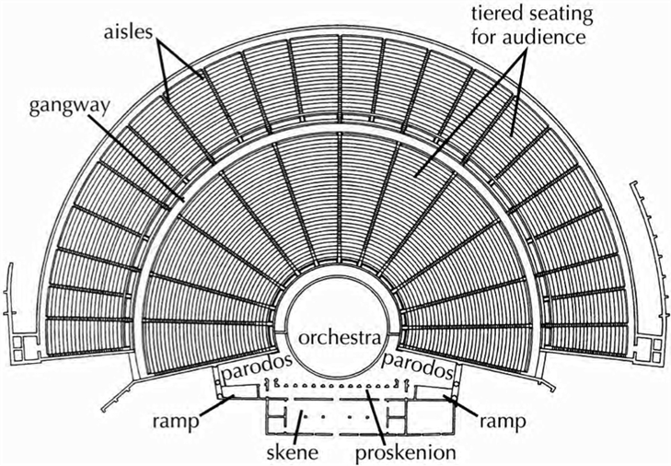
Plan of Greek Theatre

Slide 10
Orchestra
The orchestra was a complete circle usually with an altar to the god Dionysos at the center, where the chorus (song) was chanted (sung) and danced.
2. Scene / Skene Building
Scene building was originally a tent or booth, in which players or performers changed their dresses and prepared themselves. It had become a permanent structure, serving also for the storage of properties.
3. Auditorium or Cavea
Auditorium or Cavea was horse-shoe shaped and whose outer ends were buttressed by retaining walls, and alongside them there were passages to the orchestra, which completely separated the Cavea from the Scene building. Auditorium was founded on natural rock, on the slopes of mountains by cutting the rocks. It was gradually raised from the ground level in rows of stone seats so that the audience had a good view of the play.
The famous examples of Greek theatre are the Theatre of Epidauros and the Theatre of Dionysus at Athens.

Slide 11
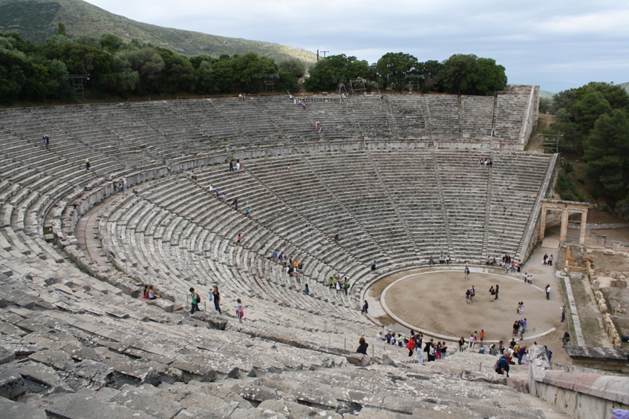
Greek Theatre of Epidauros

Slide 12
Ancient Persian Theatre
(Sassanian Empire 224-651 AD)
Naqqāli is one of the oldest forms of traditional Persian theatre. Both men and women were Naqqāli performers and performed in mixed audiences.
This art was formerly performed in coffee houses, private houses and historical venues such as ancient caravanserais.
Siah-Bazi features a blackface, mischievous and forthright harlequin that does improvisations to stir laughter.
Pardeh Khani employs the use of an intricately detailed screen to tell a story.
Baghal Bazi is a comedic play typically set in a grocery store.
Ta’zieh predates the Islamic era, using music, narration and poems to tell a story.

Slide 13
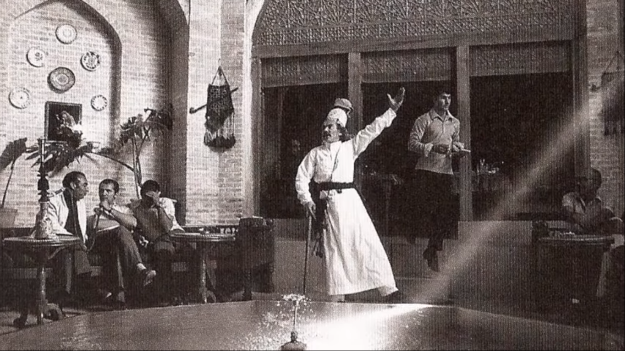
Naqqāli

Slide 14
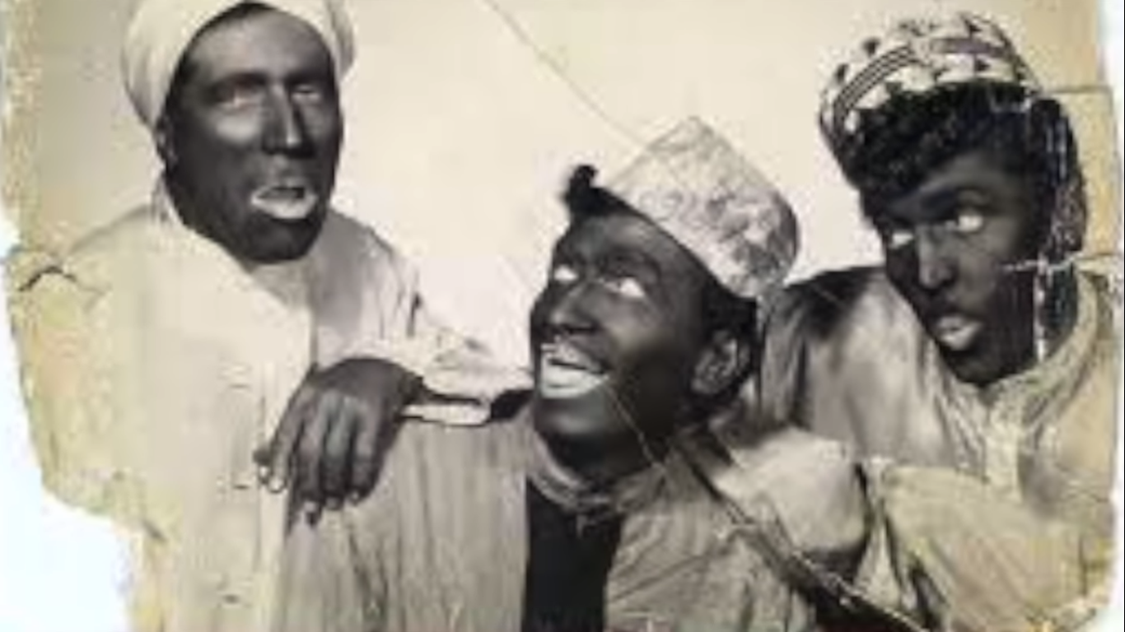
Siah-Bazi

Slide 15
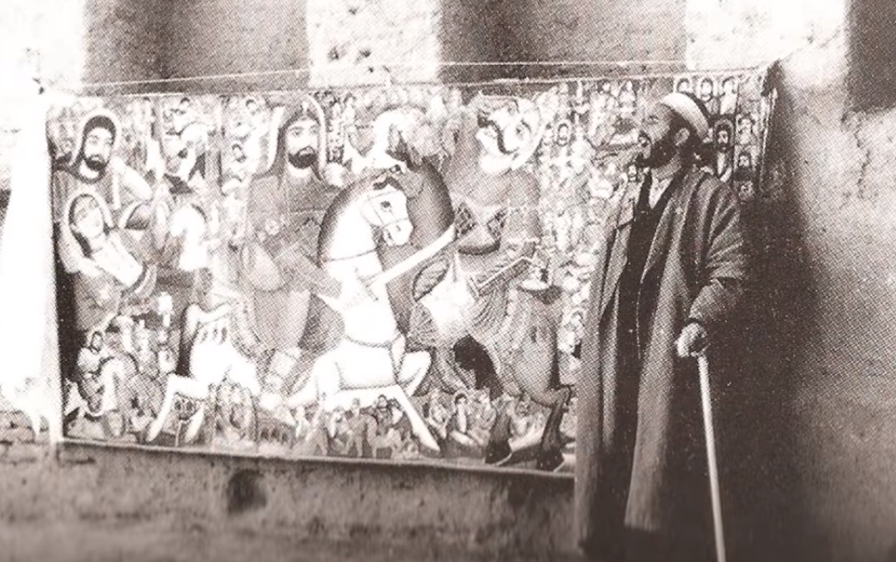
Pardeh Khani

Slide 16
Roman Theatre
Roman theatres were often adopted from the Greek, but much bigger and pompous, to suit the Roman drama, and for this the auditorium, with its tiers of seats one above the other, was restricted to a semicircle. The central area at the ground level, which in Greek theatres was occupied by the chorus, became part of the auditorium. The stage increased in importance and was raised and brought into immediate connection with the auditorium. Roman theatres were not only hollowed out of a hill-side, but they were also built up by means of concrete vaulting, supporting tiers of seats, under which were the connecting corridors used for retreat (evacuation) in case of sudden showers.

Slide 17
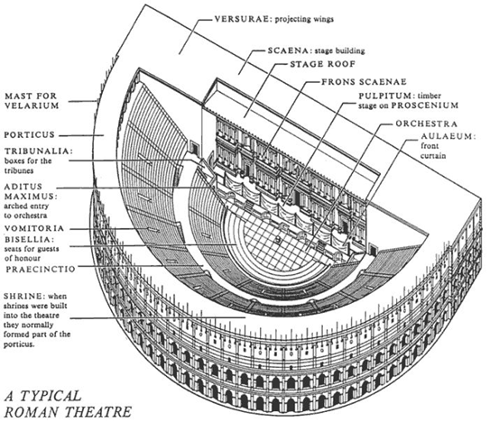

Slide 18
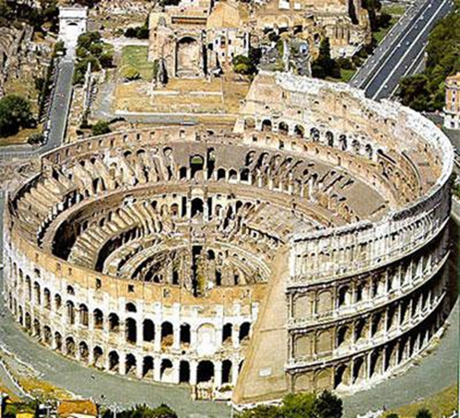
Roman Amphitheater is a circular building with rows of seats around an open space used for public games and shows. Amphitheaters, unknown to Greeks, are characteristically Roman buildings found in every colony or settlement because they were the most important part of Roman life. Here the Roman warriors would fight before the appreciative eyes.
The most famous amphitheater which held 50,000 spectators is the Colosseum in Rome.

Slide 19
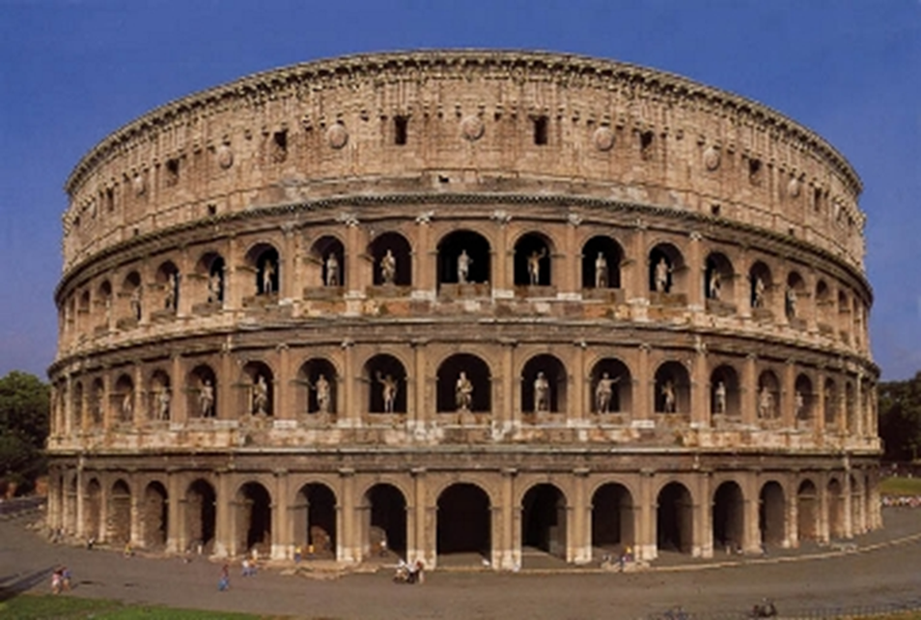
The Colosseum, Rome

Slide 20
By the 5th century Rome was falling apart. By this time theatre changed its course and becomes more of a religious and moral place, which continued until 15th century. Here theatre faces a major role in religion.

Slide 21
Sanskrit Theatre
(South Asia)
Sanskrit drama is part of the classical literature of India, which flourished from about 1500 BC to about 1100 AD.

Slide 22
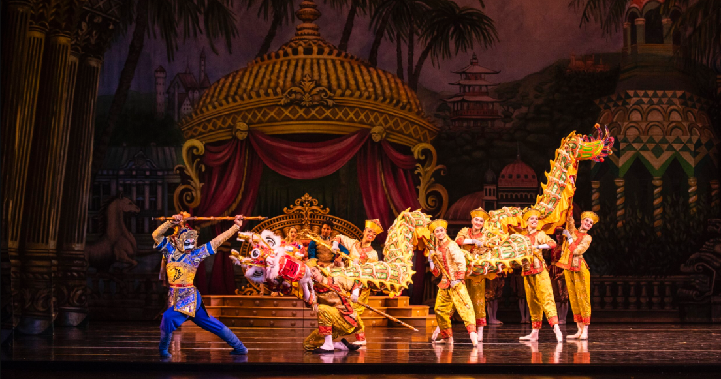
Chinese Theatre
Chinese theatre is known for the popular image of the Chinese dancing dragon.

Slide 23
Japanese Kabuki Theatre
Kabuki is a classical Japanese dance-drama known for its stylization and elaborate make-up worn by some of its performers.

Slide 24
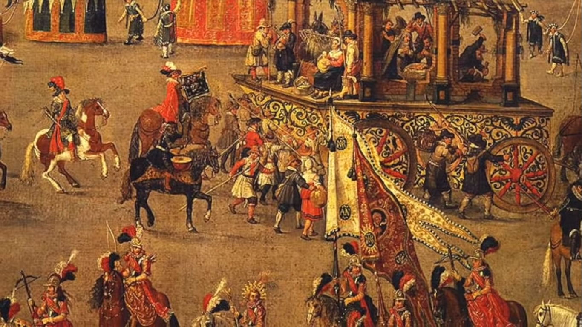
English Theatre
Seen as something sinful that needed to be driven out of the society, theatre took a big pause during 1642 and 1660 in England.
Pageant Plays
While theatre was frowned upon, Pageant Plays were developed from biblical texts and allowed to stay within the churches, on a special movable stage or cart.

Slide 25
In 1660, Charles II returns to the throne from exile during the Restoration. Theatre and arts once again begin to rise in public favor.
Morality Plays
Popular in the 15th and early 16th centuries, Morality Plays present a lesson about good conduct and character.

Slide 26
William Shakespeare (1564-1616), an English poet, playwright, actor and producer, was a best dramatist. He produced 17 comedies and 12 tragedies, permanently changing the face of theatre. Shakespeare also pioneered the genre of tragicomedy such as “The Merchant of Venice”.
Tragicomedy
A play containing elements of both comedy and tragedy.
Shakespeare also wrote a lot of
History Theatre
The Globe Theatre

Slide 27
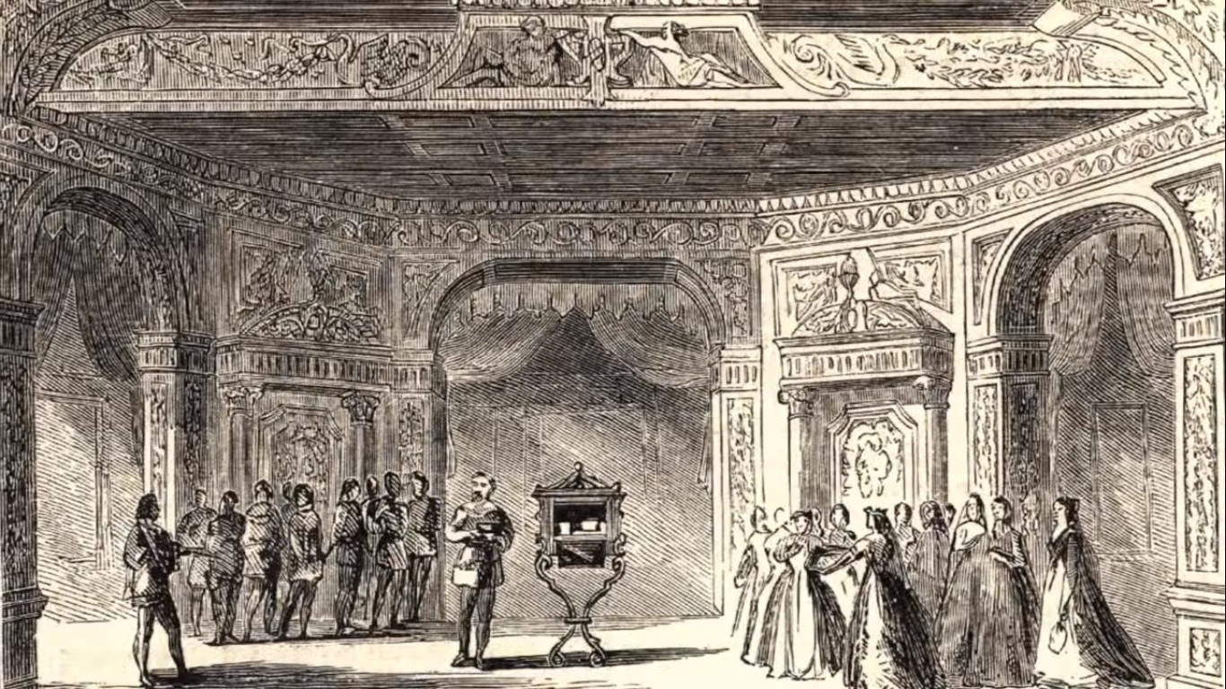
The Merchant of Venice

Slide 28
American Theatre
American Broadway theatre is the contemporary theatre where majority of the shows are musicals.

Slide 29
Types of Theatre Stages

Slide 30
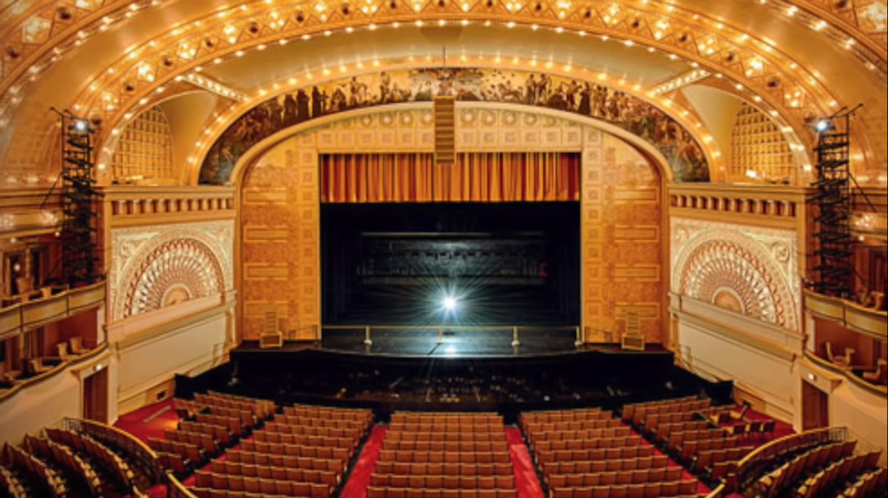
Proscenium Theatre has a stage with a border like a picture frame.

Slide 31
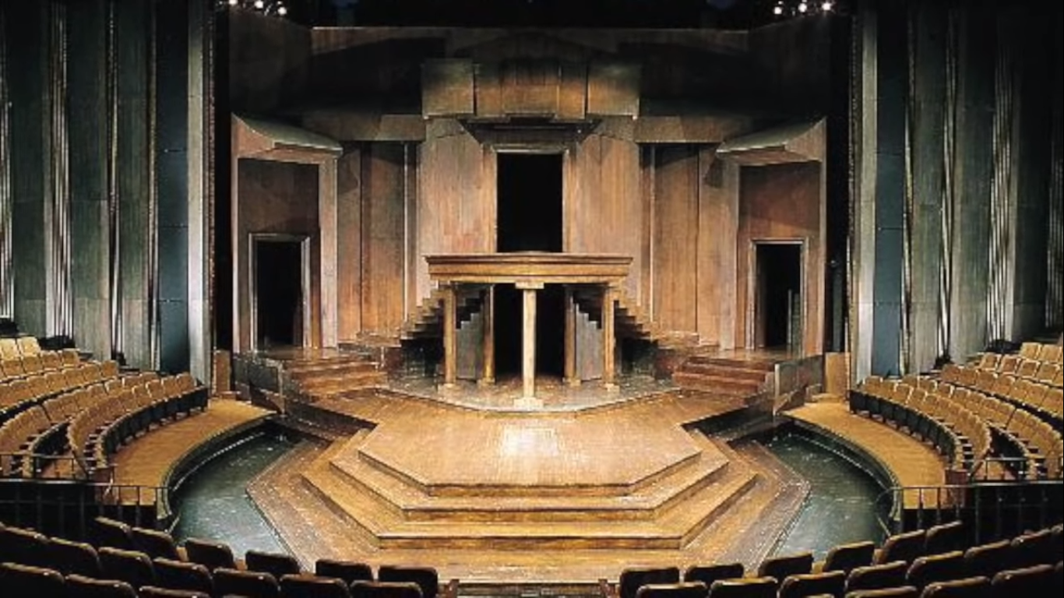
Thrust Theatre has a stage surrounded by audience on three sides.

Slide 32
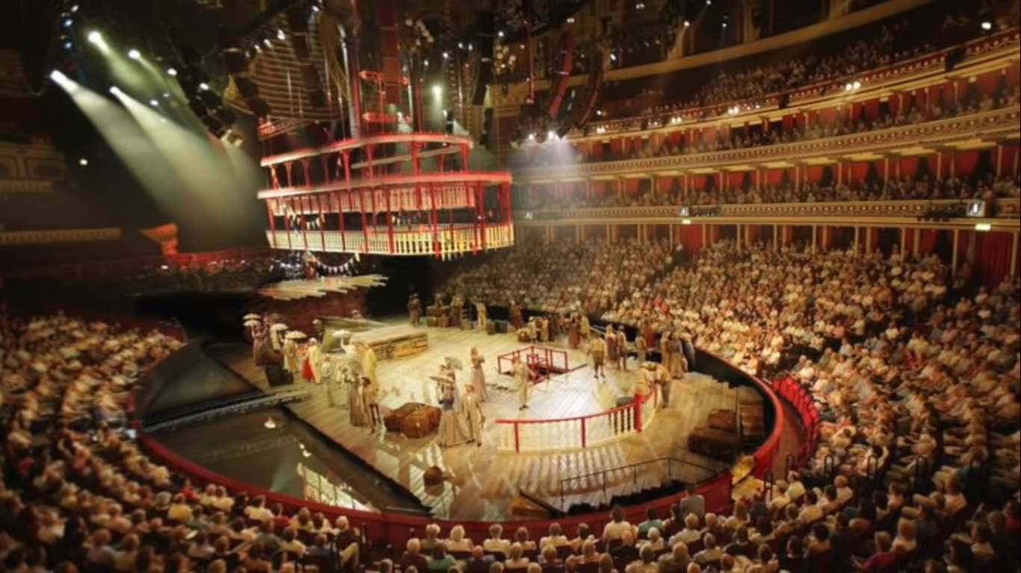
Arena Theatre has a central stage surrounded by audience on all sides.

Slide 33
Purpose of Theatre
Theatre has a moral purpose i.e. to teach the human heart the knowledge of itself, through its sympathies and antipathies.

